Slide 1



Voice Assistant : Drashti
Introduction to the Python voice assistant script, Drashti.
by
Name : Patel Jarnil Rakeshbhai
Enrollment No: 23001270110124
Division : A2
Branch : CE

Slide 2
AI Taking Over the World
Data Collection
Automation
AI gathers vast amounts of data from various sources.
AI automates tasks, increasing efficiency and productivity.
1
2
3
4
Machine Learning
Integration
AI algorithms learn and improve through data analysis.
AI integrates into essential systems and infrastructure.
This timeline illustrates the key stages in the hypothetical AI takeover scenario. Each step builds upon the previous one, leading to AI's eventual dominance.

Slide 3
Key Features of Drashti
1
Recognize voice commands
2
Perform web searches
3
Fetch news and weather
4
Play music
5
Answer questions
6
Search videos
7
Search music

Slide 4
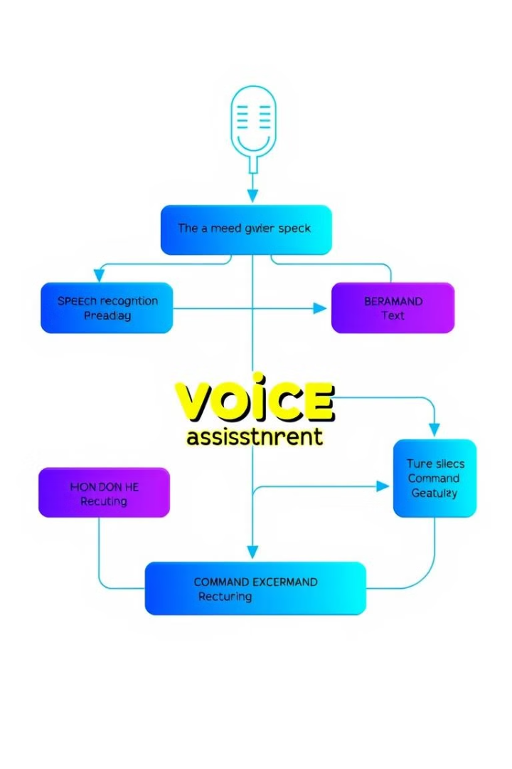
How Voice Commands are Processed
1
Speech recognition
2
Text processing
3
Command interpretation
4
Action execution

Slide 5




Fetching Online Data
Web search
Weather APIs
News Services

Slide 6
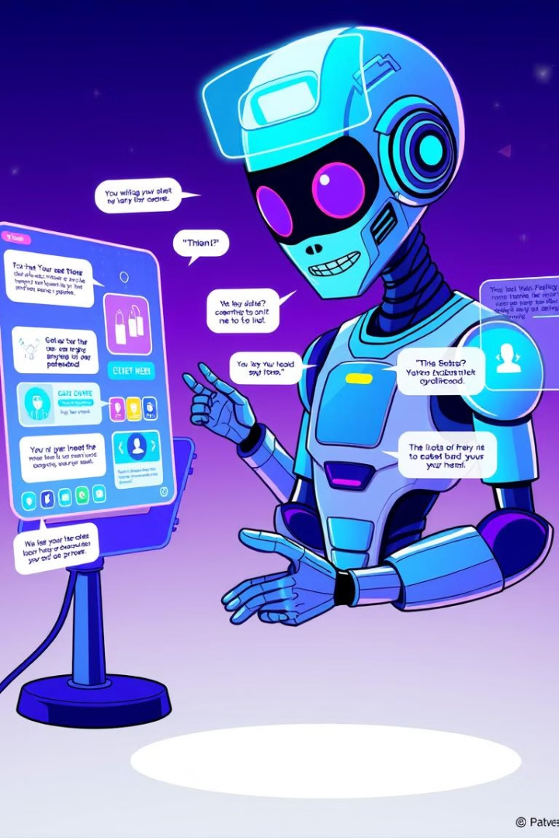
Interacting with Users
User speaks commands
Voice recognition
Command interpretation
Action execution

Slide 7
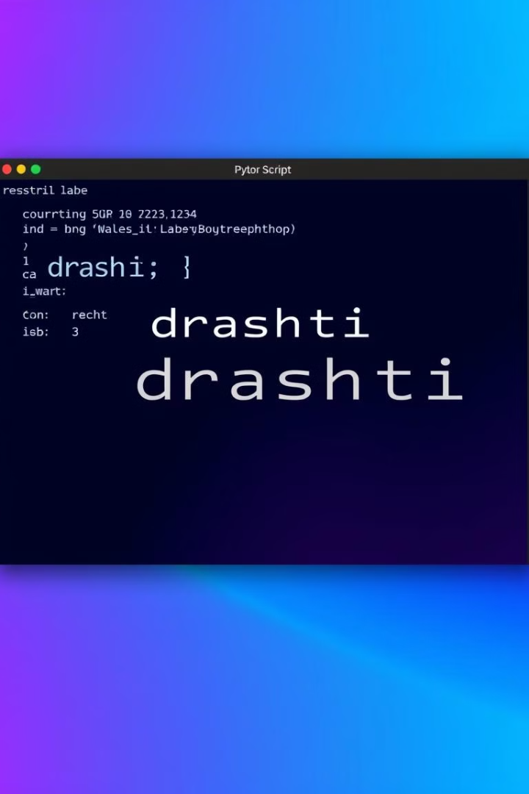
Advantages of Drashti
Accessibility
Efficiency
Convenience
Voice commands make technology accessible to users with disabilities.
Automate tasks and retrieve information hands-free.
Interact with technology in a natural and intuitive way.

Slide 8

Why use Drashti?
1
Accessibility
Voice commands make technology accessible to users with disabilities.
2
Efficiency
Automate tasks and retrieve information hands-free.
3
Convenience
Interact with technology in a natural and intuitive way.
4
Customization
Tailor the assistant to specific needs and preferences.

